Slide 1
Platform Jumping
Migration Collection from Dspace to Digital Commons
Jane Wildermuth & Andrew Harris

Slide 2
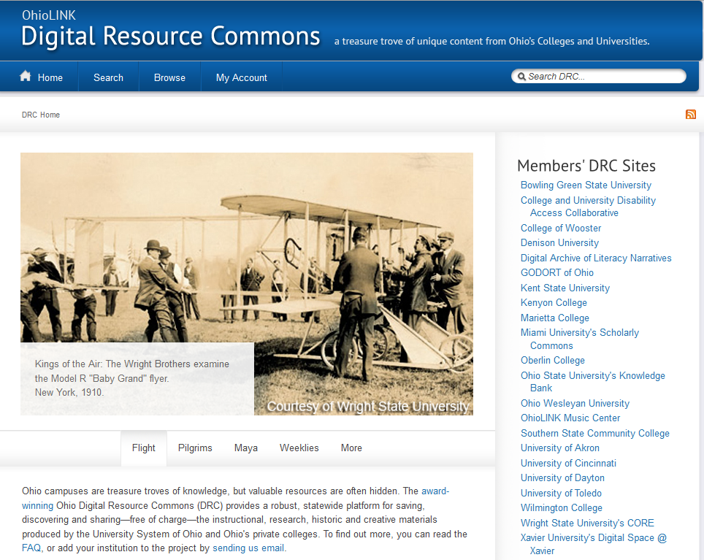
Background

Slide 3
And then it crashed
Removing wreck from injured men

Slide 4
Dspace Issues
Not flexible in overall design
Lacked Social Media/Web 2.0 tools
Lack of consistency across instances

Slide 5
Recruitment Issues
Lack of stability caused faculty to be disinterested
Lack of trust by our dean delayed our recruitment efforts
The system went down regularly

Slide 6
But there was hope…
Spectators cheering at the Harvard-Boston Aero Meet, August - September, 1911

Slide 7
Core Scholar
Signed on with bepress
Created a new position for the department

Slide 8
Migration
OhioLINK would no longer support Dspace
We began planning the migration in late February/ March
We researched several alternative platforms

Slide 9
Things got better…
Orville Wright smiles for the camera

Slide 10
Platform Chosen!
We were already using Digital Commons
It worked well with published materials
Everything would be located in one repository
Ease of training faculty/staff/students
Ease of recruiting
Ease of others understanding goals of IR

Slide 11
What about ContentDM?
Orville Wright under the wing

Slide 12
Everything isn’t Perfect

Slide 13
Issues
September 30th deadline
Planning page structure and design takes time
Streaming server

Slide 14
Handles?!
Seats and control levers on Wright Model A Flyer

Slide 15
Handles
Persistent URLs
Requires a Handle Server to maintain the PURLs
Extra expense
Eventually chose to abandon the system

Slide 16
What about the Archivists?
Street Carnival

Slide 17
Recruitment of Archives Staff
Buy-in of system
Demo by bepress staff during IR kickstart
Digital Services demoed to staff also
Not just for PDFs
Flexible system
Web 2.0/Social Media
Tie in with own blogs
Image galleries
Audio & Video
One record with more than one file type

Slide 18
For the Archives
Allowed the archivists to jointly make decisions on look, layout, metadata fields, and keywords to collect items.
Uploaded a test image collection to the demo site for setting up metadata and display

Slide 19
How involved would Archives be?
Would archivists have backend access?
Archivists know collection best and how patrons use collections

Slide 20
Searching
Lack of preview images
Several similarly titled items

Slide 21
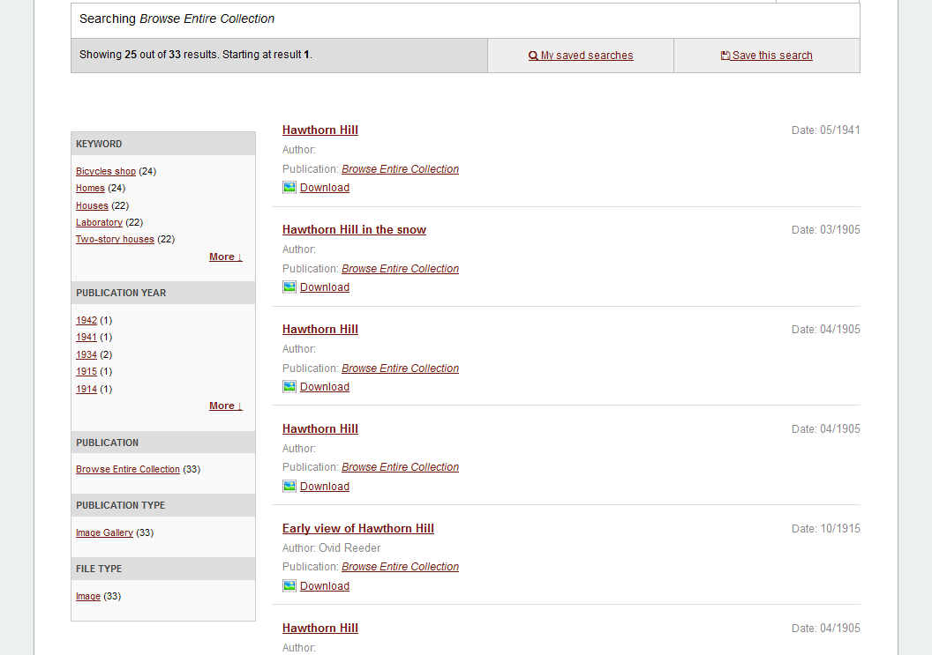
Notes:
Our collection contains several Hawthorn Hill photos with the same name.

Slide 22
Notes:
Fairfield College created an oral history collection called “American Scholars of Religion” which they then sorted into virtual collections by keyword/subject

Slide 23
Example of our Keyword Search
Notes:
Due to the size of the Wright Brothers Photographs we decided to create a similar sort-by-keyword group of virtual collections. This would allow the user to browse the large photograph collection by narrowing down their search via keyword.

Slide 24
Notes:
We approached Archives and Special Collections and asked them to sort the Wright Brothers Photographs series into keyword groups.

Slide 25
Notes:
Above is an example of one of the virtual collections we created to help the users narrow down their searches.

Slide 26
Migration…
Delagrange

Slide 27
Migration First Steps
Performed an audit of records
Counted all collections manually

Slide 28
Automated Tools to Migrate
Encountered a Perl Application
Lack of experience with Perl forced us to manually migrate

Slide 29
Beginning Migration

Slide 30
Workflow
Identify a collection for migration
Review file types and necessary metadata fields per collection
Generate Dspace spreadsheet
Copy and paste information into Digital Commons spreadsheet
Upload

Slide 31
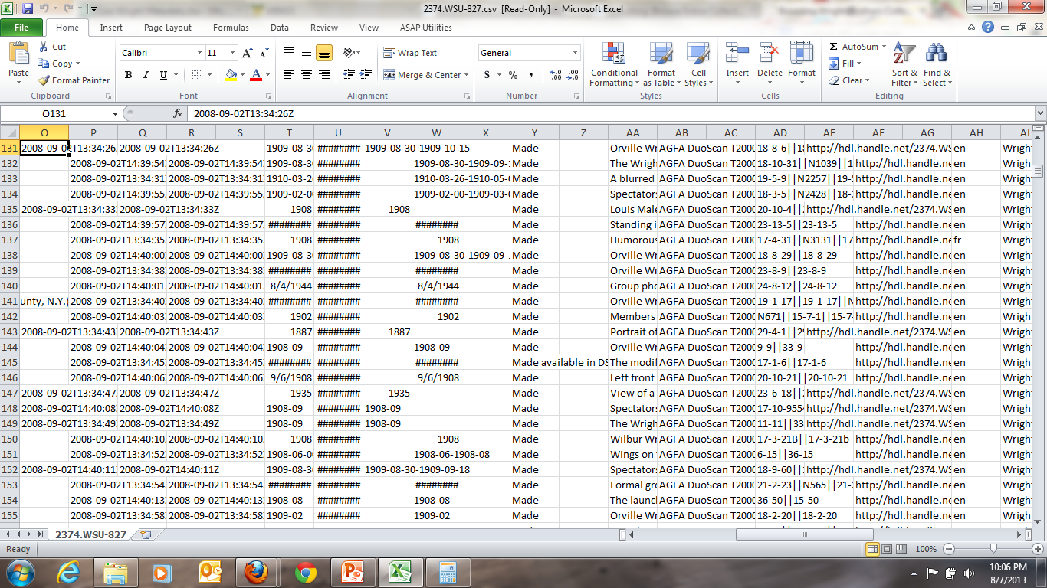
Notes:
This is a metadata spreadsheet generated by our Dspace instance. There are 27 cells containing information spread across 56 columns.
The order of information is different from the order of the Digital Commons spreadsheet.

Slide 32
Bulk Upload Tool
Learned several things about the bulk upload tool
Some fields are very specific about input
Discovered that all bulk spreadsheets go into one queue for all schools
Notes:
Do not use trailing spaces and use only lower-case letters in the document type field.
Corporate entities must be placed in the author fname field even though the standard metadata submission form places the corporate name in the institution field.
Uploading in the mornings before 11:00 EST has given me the best results.

Slide 33
Bulk-Revise Tool
Learned to also love the bulk-revise tool
Quick and easy to make edits to several files.
Learned that all bulk revise spreadsheets are syphoned into one queue for all institutions.
Notes:
Upload in the mornings before 11:00 EST for best results

Slide 34
Our story so far…
We are still in the process of migrating collections.
We have 38-40 collections left
We’ve downloaded our Dspace content
We are aiming for the September 30th deadline

Slide 35
Questions?

