Slide 1
Automating Your Way to Easy Faculty Scholarship Collection Development
Margaret Heller
Loyola University Chicago
mheller1@luc.edu || @margaret_heller

Slide 2
Introduction

Slide 3
The Problem
Faculty aren’t always motivated to participate in an institutional repository: success lies in being able to create a set of services with a an eye to quality and robust metadata.
Giesecke, Joan. “Institutional Repositories: Keys to Success.” Journal of Library Administration 51, no. 5/6 (September 2011): 529–542. doi:10.1080/01930826.2011.589340.
Liaisons can provide a personal touch, but how to get them to add this to their already busy schedules?
Remove friction through automation.

Slide 4
Approach #1: Quarterly Reports
OpenRefine
Thanks to…
Flynn, Stephen X., Catalina Oyler, and Marsha Miles. “Using XSLT and Google Scripts to Streamline Populating an Institutional Repository.” The Code4Lib Journal no. 19 (January 15, 2013). http://journal.code4lib.org/articles/7825.

Slide 5
Steps for quarterly reports
Search databases (Web of Science and Academic Search Complete).
Import into RefWorks.
Remove duplicates.
Export as CSV.
Import into Excel for data cleanup.
Import into OpenRefine and apply saved JSON.
Export into Excel and add some pretty colors and liaison names.
Save onto Box collaborative workspace and assign due date for contact.
Notes:
Excel
Open Excel and click on the Data tab, then Import from Text.
Select the text file and start the import process.
On step three, scroll over to ISSN column and import as text or the leading zeros will be removed.
Delete blank or otherwise unnecessary columns. You should end up with columns A-O.
Delete blank rows at the beginning.
Move the ISSN column to column A.
Save and open OpenRefine.
OpenRefine
Begin a new project by importing the spreadsheet.
Click on Undo/Redo, click Apply, and paste in the JSON from RefWorksSHERPAjson.txt from the N: drive.
Download the resulting file as Excel.

Slide 6
Final product

Slide 7
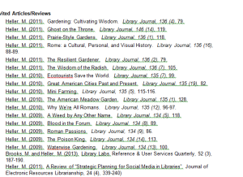
Approach #2: The poor man’s Kickstart
OpenRefine
Step by step at: Heller, Margaret. “A Librarian’s Guide to OpenRefine.” ACRL TechConnect Blog, May 1, 2013. http://acrl.ala.org/techconnect/?p=3276.
Notes:
-Realized that some faculty weren’t going to be showing up in the databases to get into RefWorks for various reasons (disciplines, RefWorks export), and it would be easier to start with their CVs.

Slide 8
Steps for CV analysis
Copy CV into text editor and clean up text as much as you can.
Import into OpenRefine.
Attempt to run saved JSON. When this doesn’t work, figure out why and repeat steps 1 &2.
If saved recipes fail, create new one by isolating each bibliographic element. Favor journal title. Then run the JSON to get SHERPA/RoMEO data.
Export the report as Excel, and clean up data as necessary.
Rename column names so they make sense to faculty.
Email with requests for post-prints.
Notes:
Copy the journal portions of the CV into a text editor such as Notepad++. The idea is to spend some time before moving into OpenRefine cleaning up the data and ensuring characters are what you expect them to be, which isn’t always clear from Word.
Open OpenRefine. Copy the text from the CV into the Clipboard section to create a new project. Note that if the CV contains different citation styles for articles and book reviews you will probably want to copy them separately.
Select Line Based Text file as import format, and uncheck the box to import blank rows.
Rename the project as author last name dash first initial. Create project.
Clean up any obviously wrong import errors (such as multiple blank rows.)
If the metadata is standard and follows one of the citation formats available, use a JSON export. Copy and paste it into the Undo/Redo tab in the Apply… option. (Make sure to remove unnecessary clauses). This may or may not work, depending on typos.
Step by step creation of JSON.
Identify punctuation that separates bibliographic elements. You will use these to separate the data into columns.
Starting from the end, click on Edit Columns…, then Split Into Several Columns… Either type in the punctuation, or a regular expression (make sure to check the regular expression box). In most cases you will want to limit the splits to 2.
Move across the citation, separating elements as is practical. The main outcome is that the journal title should be in its own column.
Rename all the columns. Title, Journal, Bib Info are the main columns you should end up with, in particular Journal.
Once Journal is separated, you will use this column as the basis for the API call to SHERPA/RoMEo. The following steps are in the CreateExtractSHERPAdataJSON.txt file.
Click on “Add column by fetching URLs…”. The expression you want to use is as follows: 'http://www.sherpa.ac.uk/romeo/api29.php?ak=bUuTIeLrUPw&versions=all&qtype=starts&jtitle=' + escape(value,'url')' Update the Throttle delay to 500 milliseconds and name the column SHERPA. If you want to make sure you have the URL right, copy and paste one of the URLs in the preview into a browser and make sure the correct XML is returned.
Extract the columns for Publisher’s PDF, Pre-print, post-print, and conditions. In each case, click on SHERPA and Select “Add Column based on this column”.
Create columns in this order:
Conditions: forEach(value.parseHtml().select("condition"),v,v.htmlText()).join(". ")
Prearchiving: value.parseHtml().select("prearchiving")[0].htmlText()
Postarchiving: value.parseHtml().select("postarchiving")[0].htmlText()
Publisher’s PDF: value.parseHtml().select("pdfarchiving")[0].htmlText()
Finally remove SHERPA.
At this point you can export the report as Excel. Look up additional items that SHERPA didn’t find (sometimes removing colons from journal names can assist with this). When sending to faculty, you should replace columns with more straightforward language, since they don’t always know what these terms mean.

Slide 9
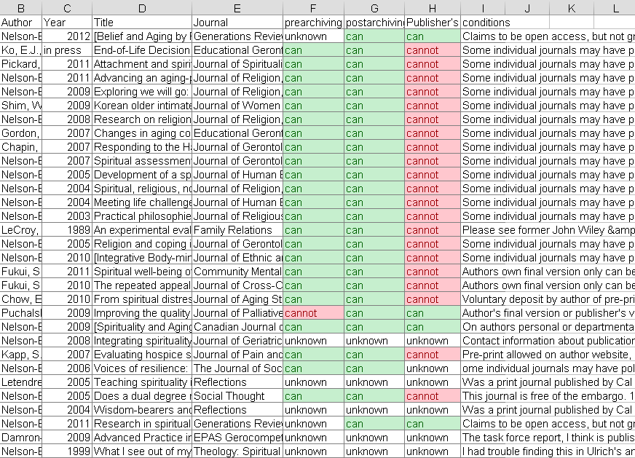
Example CV report (with some extra conditions filled in)

Slide 10
Results: 75+ items of faculty scholarship
Quarterly report
Kickstart
March 2013: 75 items identified
16% posted in repository; 25% of the total items where faculty were definitely contacted.
5 faculty had CVs analyzed thanks to contacts from quarterly report.
3 additional faculty thanks to liaison outreach.

Slide 11
What worked
Student worker dedicated to the project.
Contact faculty at opportune times.
Help liaisons when the situation gets too complicated.
Manage rights and permissions yourself.
Verify all files and metadata for user submitted content.

Slide 12
What didn’t work
Some liaisons will have a harder time following through.
Political issues can keep the project from moving forward.

Slide 13
Thank you!
Contact me at mheller1@luc.edu || @margaret_heller

