Slide 1
Tell Us What You Want To Do
Utilizing the Institutional Repository to Create an Experiential Learning Opportunity for Scholarly Communication Instruction
Jonathan Bull
DCGLUG Annual Meeting
August 8 – 9, 2013

Slide 2
Agenda
Scholarly Communication in Instruction
Using the Institutional Repository as teaching tool
Case Study: Literary Editing and Publishing (English 380)
Remaining Challenges: Scholarly Communication and institutional repositories in library instruction
Future Projects

Slide 3
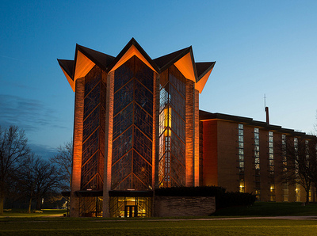
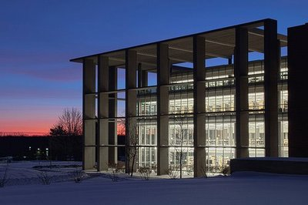
Valparaiso University (a.k.a. Valpo)
Founded 1859
50 miles southeast of Chicago, IL
Approx. 4,100 students (2,900 undergraduate; 1,200 graduate)
235 tenure-track and tenured faculty members (including librarians)
Independent Lutheran affiliation

Slide 4
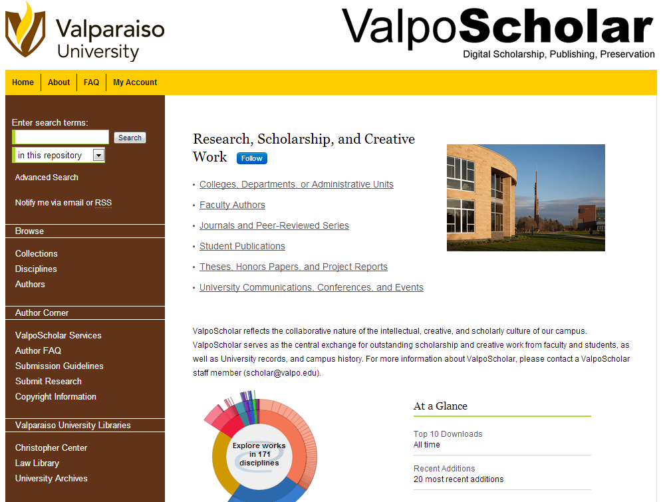
ValpoScholar
2,750 files
618,000+ downloads (since March 2011)
Four professional journals, two student publications (before this project)
Faculty scholarship from 17 departments (out of 30)
Three sets of conference proceedings
…and many other collections

Slide 5
Here’s the problem: “How do we teach scholarly communication, if we have such a difficult time just teaching information literacy and reinforcing bibliographic instruction?”

Slide 6
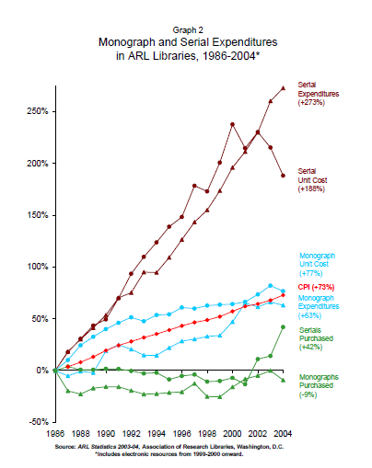
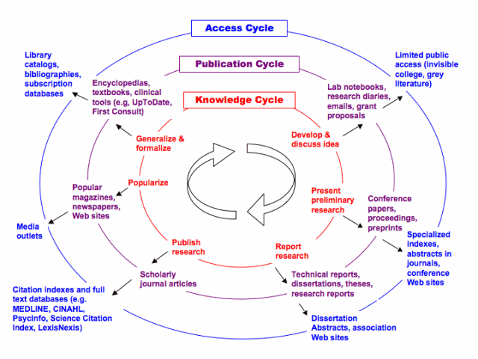
Currently…
Source: Library of Health Sciences, University of Illinois-Chicago
…but these weren’t “hands on” enough and we had only 5 minutes.

Slide 7
Institutional Repositories & “Publishing as Pedagogy”
“Why would we need to teach students that? How would we even teach that?”
-Jonathan Bull (me) in 2010

Slide 8
“Publishing as course work is becoming more pervasive, and provides an ideal opportunity for active learning.” (pg. 9) Association of College and Research Libraries. Working Group on Intersections of Scholarly Communication and Information Literacy. Intersections of Scholarly Communication and Information Literacy: Creating Strategic Collaborations for a Changing Academic Environment. Chicago, IL: Association of College and Research Libraries, 2013. Published online at http://acrl.ala.org/intersections

Slide 9
Valpo Case Study
English 380: Literary Editing and Publishing

Slide 10
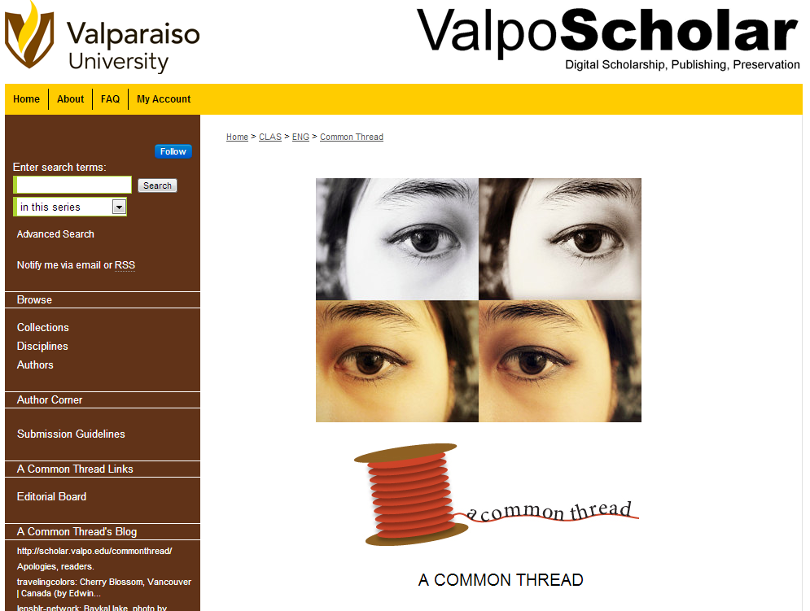
English 380: Literary Editing and Publishing
Faculty Member wanted to cover the following:
-Online Submissions
-Online Publishing
-Online Editorial Notes/Editorial Board
-Multiple Document Types (Poetry, Fiction, etc.)
-Stable URLs
-Brand Identity*
The library also supplied:
-Copyright and Intellectual Property background
-Search Engine Optimization (thanks bepress!)
-Tutorial and technical support, instruction
http://scholar.valpo.edu/commonthread/

Slide 11
English 380 – Results (since May 28, 2013)
102 submissions
Poetry, Fiction, Flash-Fiction,
Creative Non-Fiction, Artwork (Photographs)
27 files published
453 downloads
Blog integration (students taught me this)

Slide 12
The best result…the lecture disappeared
“Do we offer classes on this [scholarly communication/information literacy] stuff? It’s interesting enough, most of the time.”
–English 380 student

Slide 13
English 380 – Snippets from our conversations with the class…
“So, could we make money off this from, like, subscriptions and fees?”
“I think I get the whole digital piracy thing now.”
“I get why they [publishers] have to charge something, but why $40 an article? That’s a little extreme.”
“Why does this author keep asking when we’re going to publish? Doesn’t he read the website?”
“I can’t believe we have people submitting from Mexico. What was that Google Search like?”
“Man, a lot of these [submissions] kinda suck.”
“Could we be sued over this?”
“Why should we have a copyright statement? We’re giving it away for free.”

Slide 14
Exception, not the rule…
“I mean, you can’t make everybody a journal editor…can you?”
-English Faculty Member

Slide 15
What still needs work…
Finding a right fit for each subject
More experiential (active) learning opportunities for SC
Formal IL curriculum
More campus “culture shift”
Demonstrate impact for the students

Slide 16
A brief word of our future projects
“Tell me all about your day at work, but I do want to go to bed soon, so can you keep it short?”
-My wife

Slide 17
Questions?
Thank You!
Jonathan Bull
Scholarly Communication Services Librarian
Valparaiso University
Jon.Bull@valpo.edu

