Slide 1
Making Open Access Accessible
Engaging Staff in OA Workflows
Tim Gritten
U. of Wisconsin-Milwaukee
August 9, 2013

Slide 2
Problem
Open access “is important”
Don’t know what that means
Don’t care what that means
Not relevant to me

Slide 3
UWM Fast Facts
University of Wisconsin-Milwaukee
30k students
2.2 million library volumes
1.2 million visitors
75 full-time library staff
UWM Digital Commons
Officially launched Feb 8, 2013
http://dc.uwm.edu/

Slide 4
Old Workflow
IR
ETD
E-Journals
Photo: http://bit.ly/13IsooL

Slide 5
Initial Tasks
IR
Create publication collections
Usage Statistics
ETD
Create thesis submission workflow
Usage statistics
E-Journals
Publish campus e-journals
Usage statistics

Slide 6
GO!
Photo: http://bit.ly/19R9nJ8

Slide 7
Other duties as assigned
Photo: http://bit.ly/14quMF2

Slide 8
Authority & Responsibility
Photo: http://bit.ly/134z86J

Slide 9
Call for Volunteers
Photo: http://bit.ly/17BSVq2

Slide 10
Harnessing Interest
Photo: http://bit.ly/18f3rWi

Slide 11
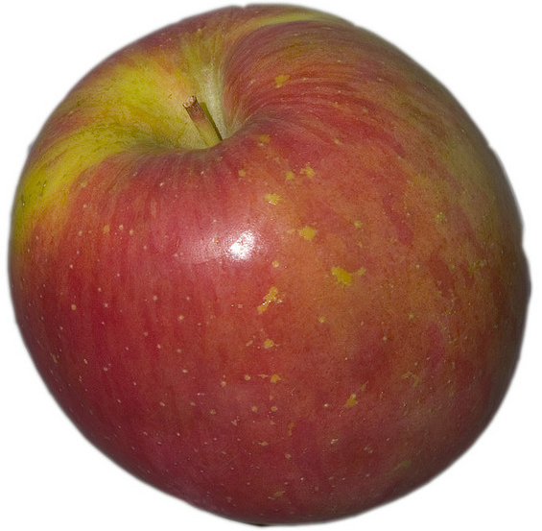
Education
All-staff meetingS
Copyright
Basics of open access
Importance of open access

Slide 12
Challenges
Introducing open access to campus
Library’s role in issue
Staff’s role in issue

Slide 13
Work organization
Advocacy—public service, marketing, department heads
Users—liaisons who touch different colleges
Content—tech services, web, digitization
Umbrella committee

Slide 14
General Operating Principles

Slide 15
Manageable Goals
Advocacy: Tell the story of Open Access
Users: Develop the relationship between faculty and the library
Content: Ensure access

Slide 16
Guiding Principles
Clear mission
We’re here to broaden the reach of your academic research

Slide 17
Advocacy Tasks
Advocacy
Create talking points
Create publicity content
Work with deans (especially new deans), Faculty Senate, New Faculty Orientation, newly retired faculty, University Library (Advisory) Committee
Statistics
General for wide audience
Specific for individual users

Slide 18
Users Tasks
Proactively identify potential users and content
conference organizers
faculty websites (which can be the content itself)
scholarship celebrations
struggling publications
grant-funded research projects
Listen for publishing problems library might solve
Leverage existing department contacts
Create FAQ/Users Guide

Slide 19
Content Tasks
Decide where content will live on website and how will it be presented
Create web presence to showcase publicity content
Develop library-based publishing services

Slide 20
Engaging Staff
Distributed Responsibilities
Kibitzing
Intellectual curiosity
Solving problems

Slide 21
Creating Teams
Speaking with Supervisors
Personal Invitations
You are needed

Slide 22
Throughout the Library
Circulation
Archives
User Services
Technical Services
Special Collections
Reserves
Systems
Admin Office

Slide 23
Brainstorm Ideas
You understand open access, now what should we do?
What material should we place in DC?
Who should we contact?

Slide 24
Buy-in
Problem Solving
Staff take ownership of the issue
Staff doing what they are good at
Art (Promotion)
Organization (Open Access Day)
Finding Answers (FAQ)
Building campus connections (Music and Theater ephemera)
Notes:
Open Access to the Bar (Happy Hour)

Slide 25
Delegation

Slide 26
Give Up Control

Slide 27
Questions?
Tim Gritten
gritten@uwm.edu

